Slide 1
Attention and Workload
From material developed by
Dr. D. C. Chandra

Slide 2
Overview
Information processing & memory
Attention
What is attention and how do we study it?
Models of attention
Auditory and visual attention demos
Control of attention
Multi-tasking and distributed attention
Design considerations for attention
Mental workload

Slide 3
Human Information Processing
Attention
resources
Stage 1
`
Stage 3: Action
Response execution
Stimuli
Sensation & Perception
Decision & response selection
Response selection, etc.
Working memory
Stage 2:
Cognition
Long-term memory
Feedback

Slide 4
Short-term Memory
From PV Chapter 10 (not assigned)
Sensory storage < 1 second
Iconic and echoic memory traces
Pre-attentive, automatic
Short-term/Working Memory
Verbal & spatial info
phonetic loop/visuo-spatial sketchpad
Limited by capacity, duration, similarity, attention
7 ± 2 perceptual chunks
Info decays over time unless rehearsed
Vulnerable to distraction in same modality

Slide 5
Long-Term Memory
Semantic (general knowledge)
Knowledge gained through learning and structure
Associative networks (activation)
Schemas, mental models, cognitive maps
Deep processing
Frequency and recency
“Forgetting” occurs due to lack of the above, or interference
Recall versus recognition
Which is harder?
Recall

Slide 6
What is Attention?
Attention is associated with “consciousness” and “awareness”
As opposed to “automaticity” or “automatic processing”
Attention “connects” perception and cognition
It is an “executive” function used to select specific information of interest from a busy environment
It can also be used to take in a lot of general information at one time from across the environment
We use metaphors to model attention
Filter, bottleneck, spotlight, (limited) resource
Some words to describe attention
Focused, selective, divided, distributed

Slide 7
Studying Attention
Attention can be studied using different perceptual stimuli and tasks
Initially studied auditory tasks, then visual tasks, then multi-modal tasks
Recent studies in attention use functional MRI (fMRI) to see what areas of the brain are active during the task
Attention involves multiple areas of the brain (varies based on task)
Damage to parietal lobe is associated with clinical attention deficits

Slide 8
Bottleneck (Filter) Models of Attention
Selective attention tasks (typically auditory)
Where exactly is the bottle neck (early or late) in information processing?
Broadbent’s filter theory (early)
Treisman’s filter attenuation theory (late)
Deutsch & Deutsch (late)
Is the bottleneck a structural limitation (bug) or an optional strategy (feature)?

Slide 9
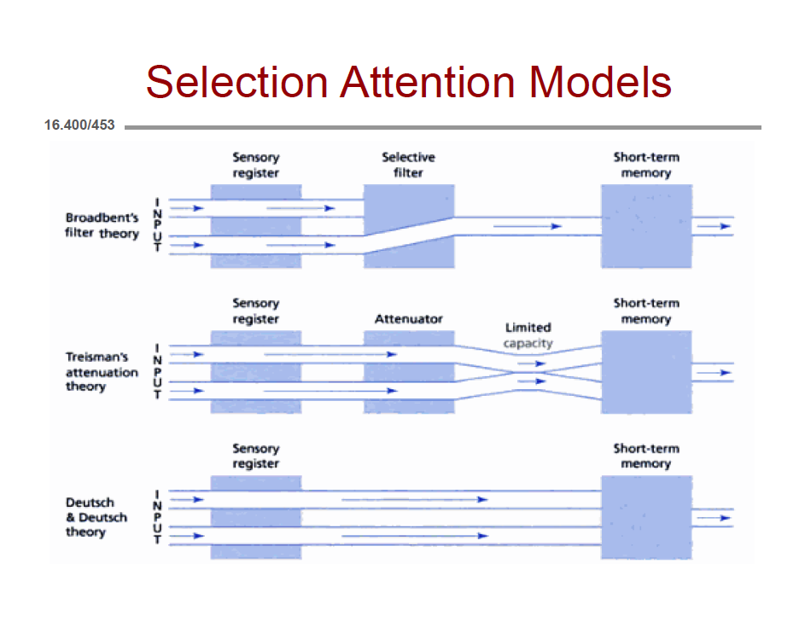
Sensory register is preattentive, temporary, unlimited storage
Selection is based on primitive features (e.g,. intensity, pitch, location)

Slide 10
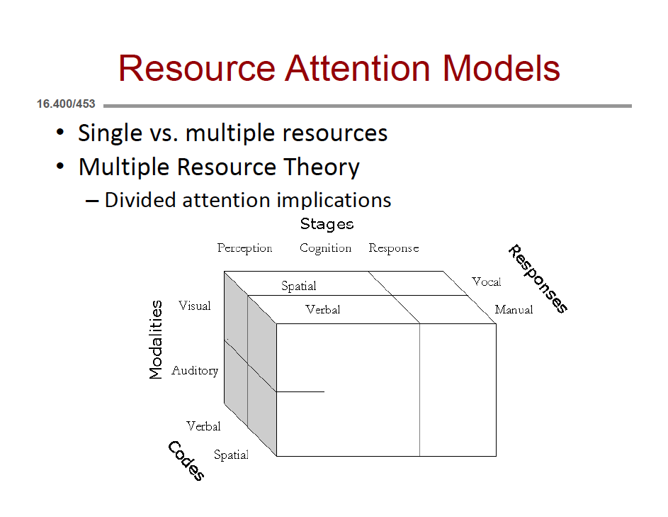

Slide 11
Contemporary Models of Attention
Spatially-based Feature-Integration Theory (Treisman)
Visual search (is a target present in a visual array?)
Preattentive vs. attentive stages of processing
Executive Control Model (EPIC) (Meyer & Kieras)
Attention is modeled as an unlimited resource
Executive strategies (e.g., task scheduling) are the source of decrements in multiple-task performance

Slide 12
Auditory Attention Demo
http://www.gocognitive.net/demos
Selective Attention
http://www.gocognitive.net/demo/selective-attention-auditory-demonstration
cocktail party effect

Slide 13
Visual Attention Demos
Asking for Directions
http://www.youtube.com/watch?v=vBPG_OBgTWg
Still photo demo
http://www.gocognitive.net/demo/change-blindness
Spotlight Metaphor
Attention can be aligned with direction of gaze, or directed to be independent of fixation
What you are “attending to” can be different from where your eyes are focused
e.g., team sports

Slide 14
Control of Attention
Involuntary
Aka exogenous
Bottom-up processing, stimulus driven
Attention grabbing
e.g., flashing lights, sudden movements and sounds, tv images
Voluntary
Aka endogenous
Top-down processing, under executive control
Deliberate
Controlled attention as intended
e.g., a sign directing you where to look, cocktail party effect

Slide 15
Multi-tasking and Distractions
What exactly is “multi-tasking?”
Multi-tasking is “task switching” (can be fast, but still switching)
Multi-tasking ≠ parallel processing
Task switching comes with cognitive “switching costs”
Multi-tasking is interrupt-driven
Multi-tasking performance improves with practice, but performance on each of the tasks does not match the performance when performed one at a time
Tasks that are similar interfere with each other more than tasks that are dissimilar (cf. multiple-resource theory)
http://gocognitive.net/video/david-strayer-driver-distraction-and-cell-phones (18 min video)
http://www.npr.org/templates/story/story.php?storyId=95256794&ps=rs
http://www.npr.org/templates/story/story.php?storyId=95524385&ps=rs
http://www.apa.org/news/press/releases/2001/08/multitasking.aspx

Slide 16
Distributed Attention
For global scene registration as opposed to detailed scene analysis
Parallel processing mechanism
Better for estimation of overall pattern
e.g., registering emotion or ‘average’ tilt of several objects in a scene

Slide 17
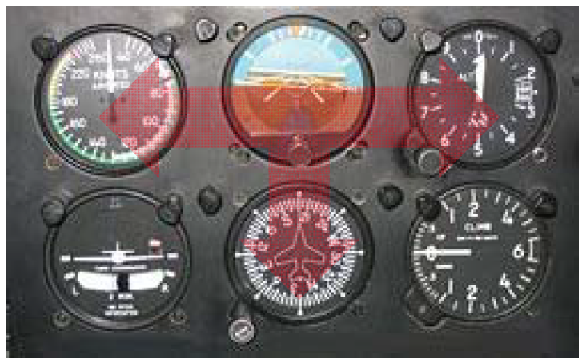
The Instrument Scan
Multi-tasking or distributed attention?
Similar task for auditory attention would be to conduct an orchestra
Requires practice and proficiency!

Slide 18
Display Design and Attention
Color Coding
Filtering out “relevant” info via color coding
Takes advantage of parallel processing
But what is relevant depends on the specific task and the number of useful colors is limited
Flashing
Grabs attention, high frequency or extra bright is especially grabby
But can be distracting

Slide 19
More on Display Design and Attention
Size/Loudness
Big/loud objects can attract attention
But too big or too loud can backfire
Distinctiveness from background is more important
Feature contrast
e.g., easy to find a straight line segment amongst curves
Difficult when there are many visual objects, all different

Slide 20
“Visual Clutter” and Attention
Both cognitive and perceptual organization of information affects perceived level of clutter
Experienced observers see structure where inexperienced observers do not (chunking)
e.g., reading (text, math equations, music)
Some perceptual features are processed in parallel rather than in serial
Visual Search Demo (cf. Treisman Feature-Integration Theory)
http://www.gocognitive.net/demo/visual-search

Slide 21
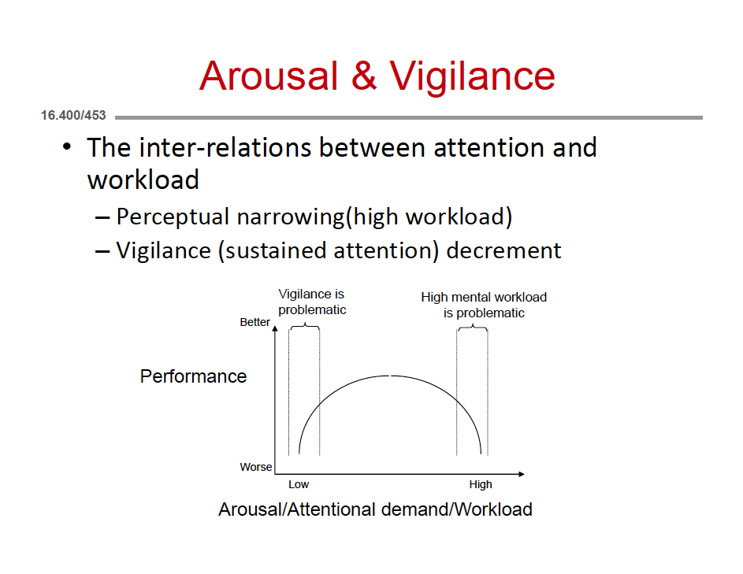

Slide 22
Workload
Workload can be physical or mental
Mental workload refers to cognitive demands over a time period
Based on unitary-source or multiple resource models of attention
Empirical measures include
Task performance (on primary or secondary task)
Subjective scales
Psychophysiological data
Workload that is either too low or too high is not optimal

Slide 23
Secondary Tasks
Assume attention is a limited resource
One task is manageable by itself, but adding the second task makes it hard to maintain performance
Instruct subjects which task to pay more attention to
Loading task paradigm
Secondary task is more important
Performance on primary task suffers if the primary task is hard
Subsidiary task paradigm
Primary task is more important
Performance on secondary task suffers if the primary task is hard
Recommended for Project 3

Slide 24
More on Secondary Tasks
Examples
Probe task (e.g., simple RT to a light)
Tracking task (keep a variable within boundaries)
Reading, listening, mental arithmetic
Problems
Can be intrusive
Effect varies with modalities of two tasks
Interpret results carefully

Slide 25
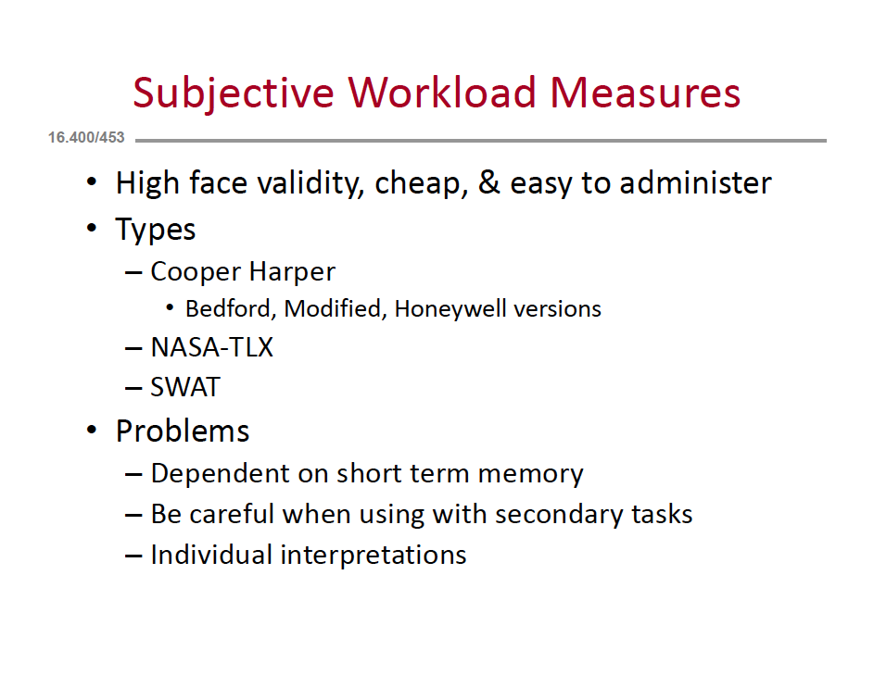

Slide 26
NASA Task Load Index (TLX)
6 dimensions of workload (next slide)
Rate effort for each along a linear scale
Rank the 6 dimensions via 15 pairwise comparisons
Pros
Easy to administer, widely used, long history
Cons
Tedious for subject (takes time and patience)
Interrupts the task
Performance scale may be confusing

Slide 27
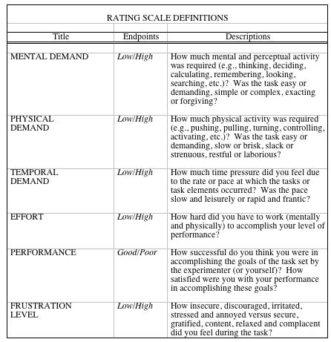
NASA TLX Dimensions and their Definitions
From Hart, HFES 2006.

Slide 28
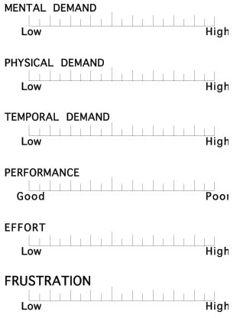
NASA TLX Rating Scales
From Hart, HFES 2006.

Slide 29
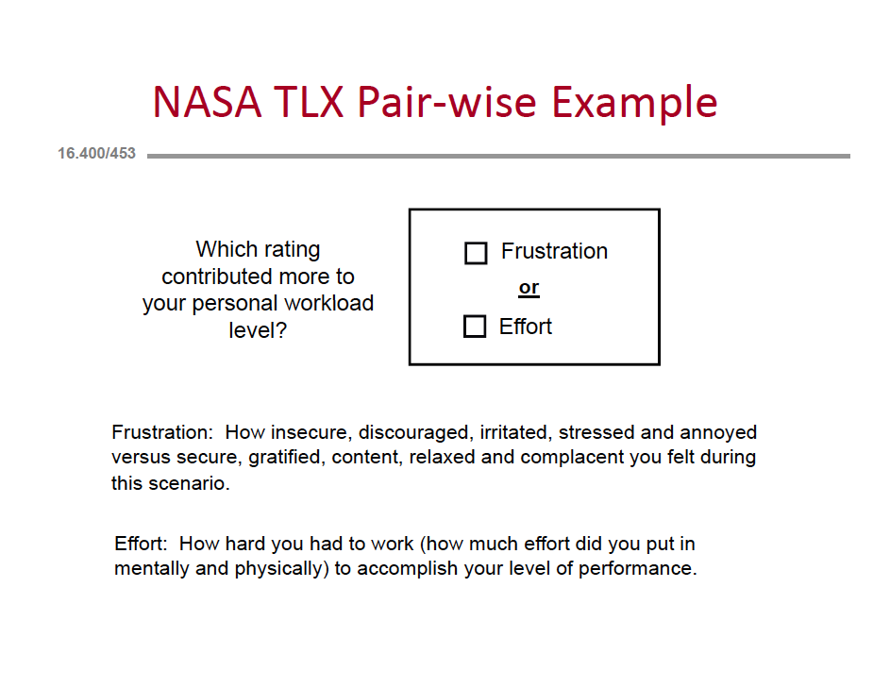

Slide 30
NASA TLX Information
http://human-factors.arc.nasa.gov/groups/TLX/tlxpublications.html
Many software versions available for download

Slide 31
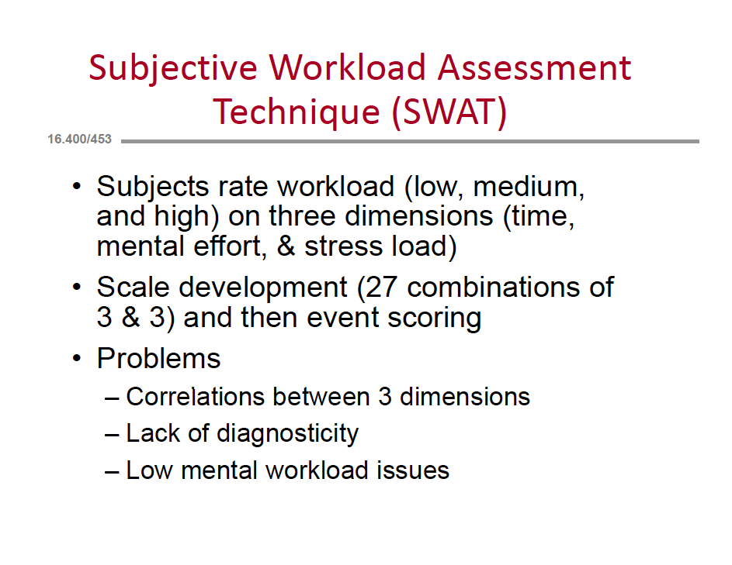

Slide 32
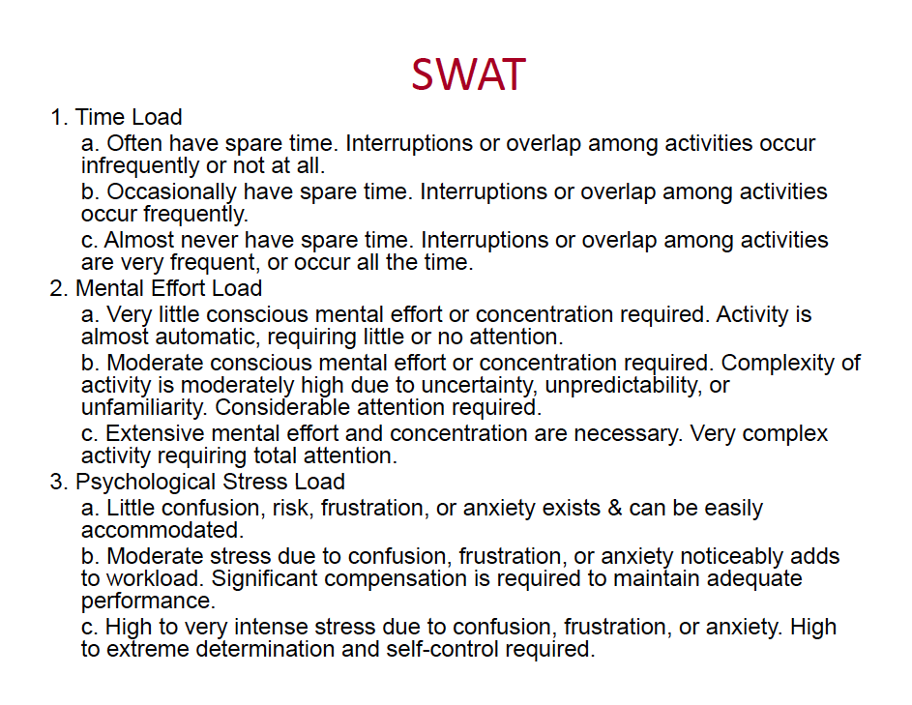

Slide 33
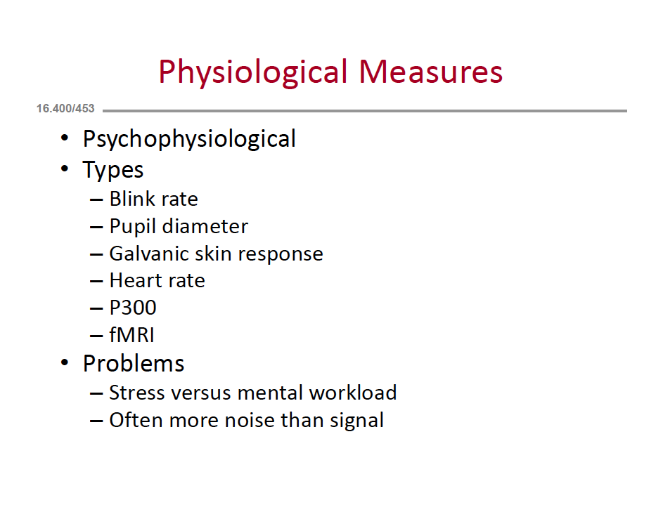
of Mental Workload

Slide 34
Extension Readings (For Fun)
The Checklist Manifesto: How to get things right by Atul Gawande
Distracted, The erosion of attention and the coming dark age by Maggie Jackson

